Slide 1
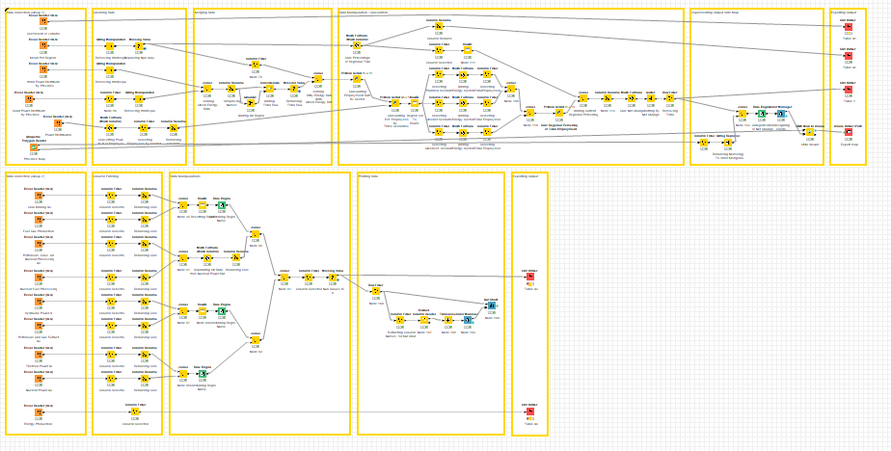
The Workflow for Data Analysis
Group 1
Group 2
For our convenience, the workflow is divided into group 1 and group 2.

Slide 2
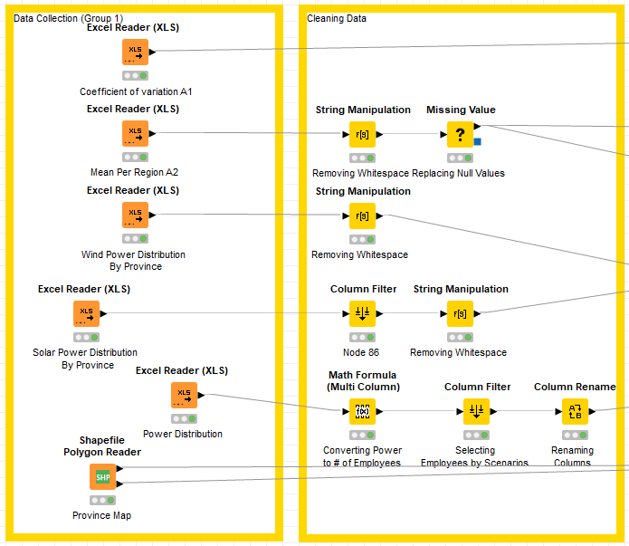
The Workflow for Data Analysis (Detailed)
Data Collection Stage: collection of raw data and initialization of shapefile mapping node
Cleaning Data Stage: cleaning
String Manipulation:

Slide 3
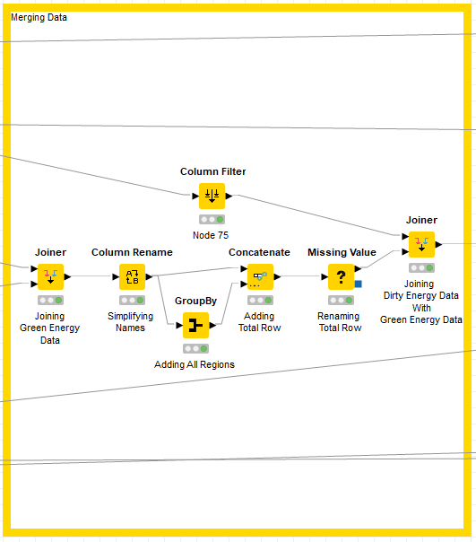
The Workflow for Data Analysis (Detailed)
Merging Data Stage:
Joiner: This node joins two tables in a database-like way

Slide 4
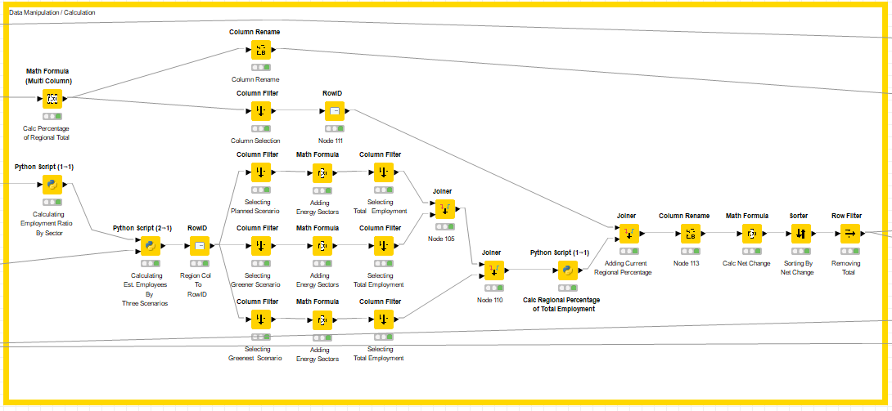
The Workflow for Data Analysis (Detailed)
Merging Data Stage:
Joiner: This node joins two tables in a database-like way

Slide 5
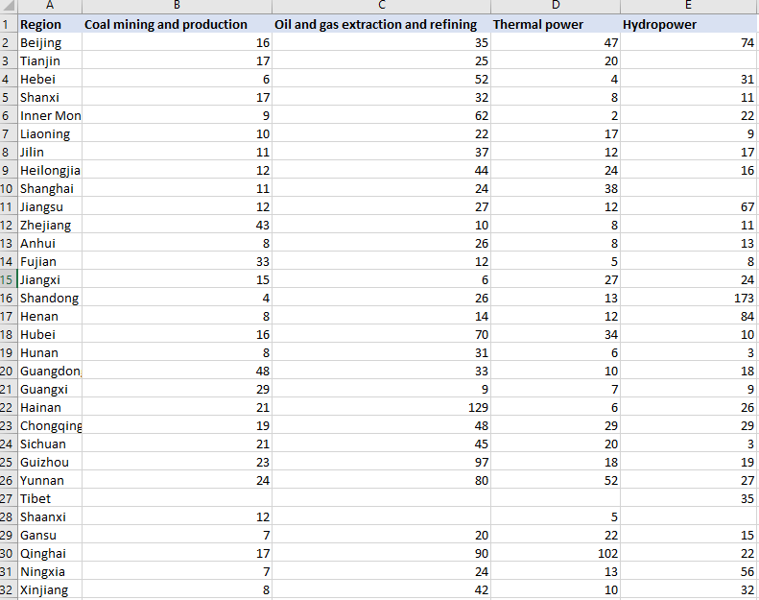
Case Study
Table A1: Coefficient of variation within regional/sectoral employment
Displays coefficient of variation of employment between coal, oil/gas, thermal power, hydropower by province

Slide 6
Output of the Workflow
Table A1: Coefficient of variation within regional/sectoral employment
Displays coefficient of variation of employment between coal, oil/gas, thermal power, hydropower by province

Slide 7
Output of the Workflow
Table A1: Coefficient of variation within regional/sectoral employment
Displays coefficient of variation of employment between coal, oil/gas, thermal power, hydropower by province

Slide 8
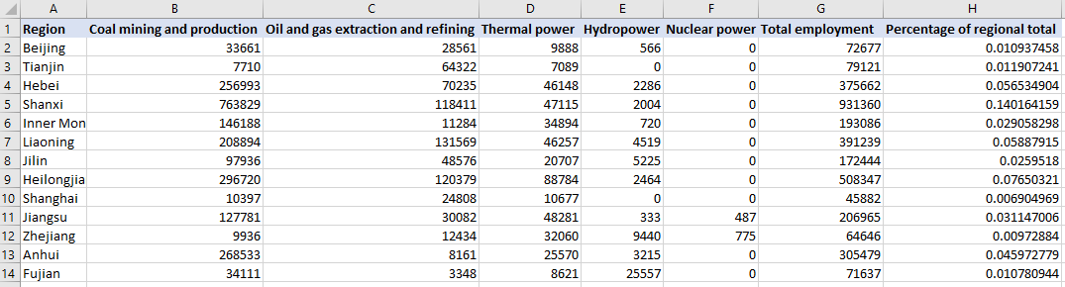
Output of the Workflow
Table A1: Coefficient of variation within regional/sectoral employment
Displays coefficient of variation of employment between coal, oil/gas, thermal power, hydropower by province
“Percentage of regional total”: Energy Sector Employees In Each Region / Total Energy Sector Employees

Slide 9
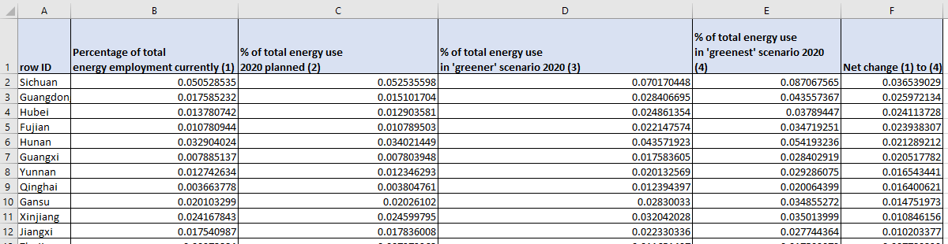
Output of the Workflow
Table 1: Regional percentage of total employment in four scenarios
row ID: Province Name Percentage of total energy … currently (1): Historical data of percent employment distribution between province (2007) % of total energy use 2020 planned (2): Percent employment distribution according to conventional plan % of total energy use in ‘greener’ scenario 2020 (3): Percent employment distribution for greener scenario % of total energy use in ‘greenest’ scenario 2020 (4): Percent employment distribution for greenest scenario Net change (1) to (4): Difference in scenario (1) and (4) employment percent distribution

Slide 10
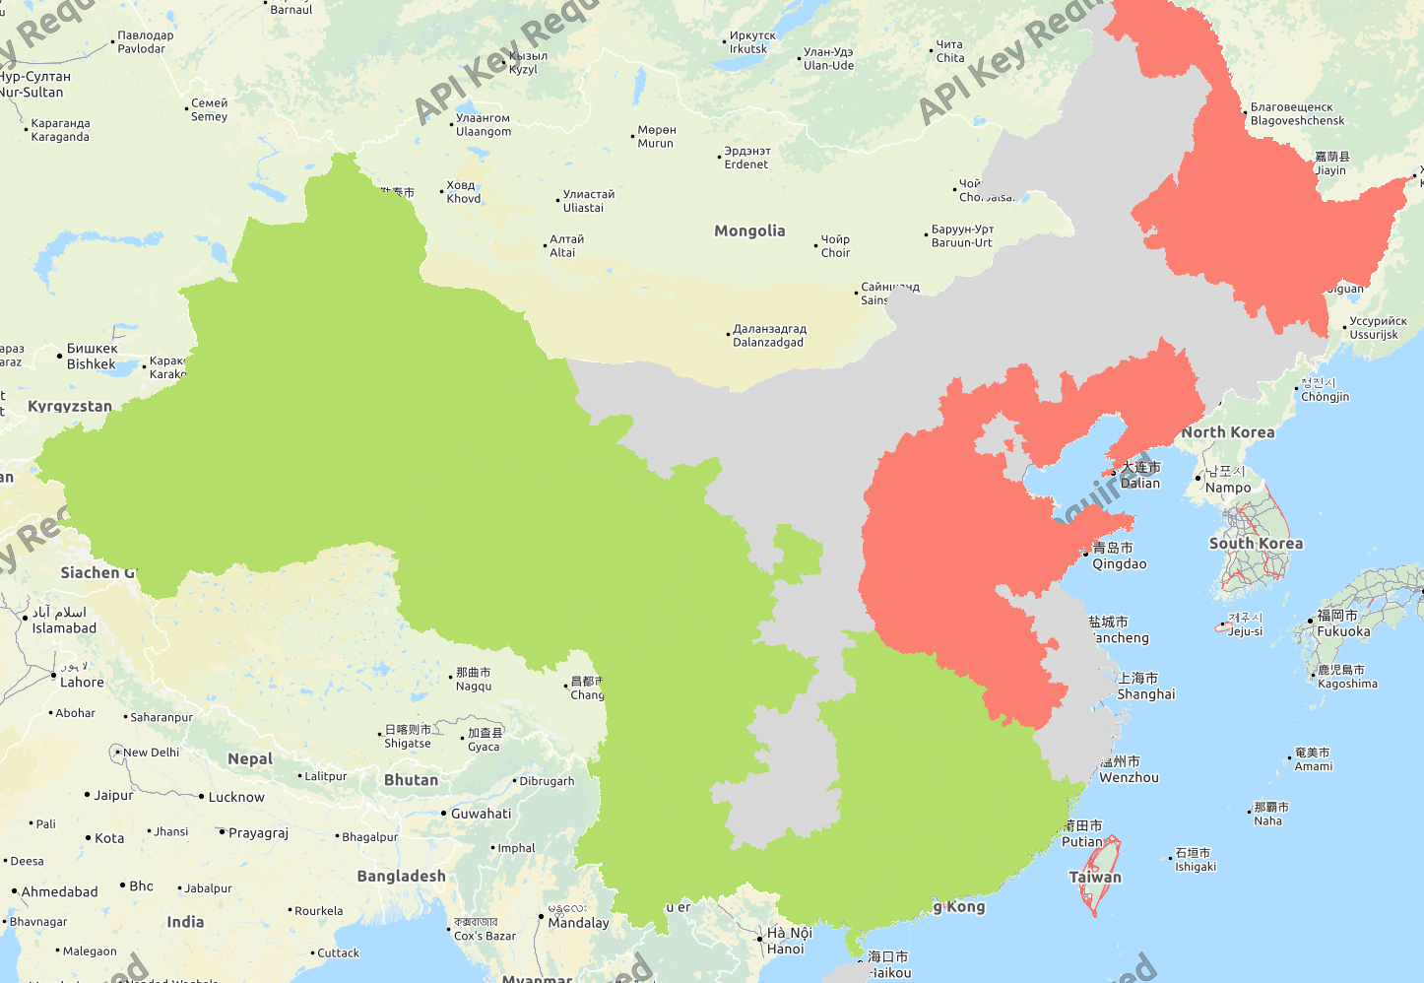
Output of the Workflow
Figure 1: Net Winners and Losers of “Greenest” Transition
Red: Provinces with a significant employment distribution loss
Gray: Provinces with small or no change in employment distribution
Green: Provinces with a significant employment distribution gain

Slide 11
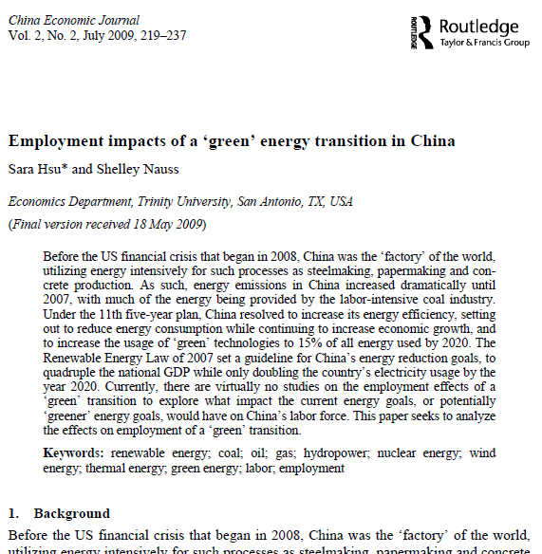
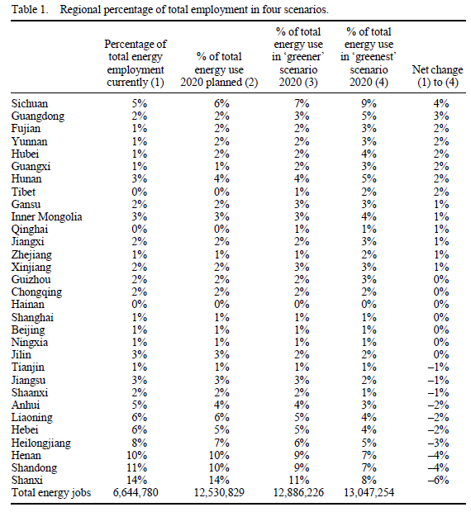
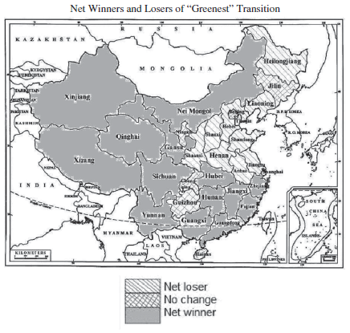
Case Study Three: Employment Change From Green Transition
Sara Hsu & Shelley Nauss (2009) Employment impacts of a ‘green’ energy
transition in China, China Economic Journal, 2:2, 219-237, DOI: 10.1080/17538960903083533
Objectives: To predict change in employments due to China’s transition into greener energy sources
Data Sources
China Data Online
China Industrial Yearbook
Data
Mean and Coefficient of Variation Within Regional/Sectoral Employment
Regional Energy Employment
Energy Production (1995-2006)
Energy Production Distribution According to Four Scenarios
Multiple energy employment data for each energy sectors

Slide 12
Case Study Three: Employment Change From Green Transition
Methodology
From the distribution of jobs and energy production each energy from historical data, the distribution of jobs in 2020 under the 11th year plan is calculated. Then, from ‘greener’ and ‘greenest’ scenarios, the effects of a hypothetical energy industry transformation on job creation and destruction is estimated.
Flowchart
Data Inputs
Data Analysis
Outputs
Data Extraction from CDI and CIY
Mean Distribution of Employment
Distribution of Employment in Four Scenarios
Tables
Bar Chart
China ESRI ShapeFile
Regional Energy Employment
Map

Slide 13
Case Study Three: Employment Change From Green Transition
Outputs from the Workflow
Mean Per Regional/Sectoral Employment (1999-2007)
Net Winners and Losers of “Greenest” Transition
Red: Provinces with a significant employment distribution loss
Gray: Provinces with small or no change in employment distribution
Green: Provinces with a significant employment distribution gain
Regional percentage of total employment in four scenarios

Slide 14
Online Demonstration

Slide 15
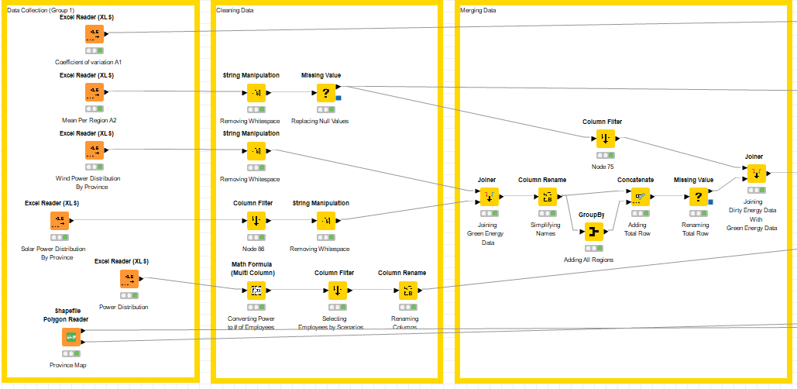
Case Study Three: Employment Change From Green Transition

Slide 16
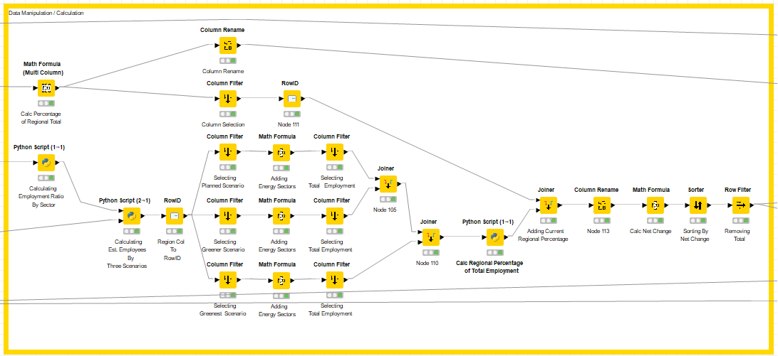
Case Study Three: Employment Change From Green Transition

Slide 17
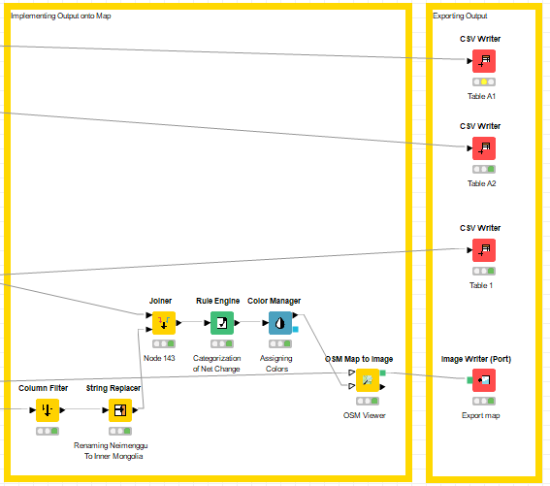
Case Study Three: Employment Change From Green Transition

Slide 18
Case Study Three: Employment Change From Green Transition
Steps for Running the Workflow
Step 1: Download data and unzip from https://drive.google.com/drive/folders/1OX-G2w6nSDVuVKEkrQ4EwZ5UhhNkmCLB?usp=sharing
Step 2: Download workflow from https://drive.google.com/drive/folders/1OX-G2w6nSDVuVKEkrQ4EwZ5UhhNkmCLB?usp=sharing
Step 3: Open KNIME from local PC or China Data Lab Cloud Platform (in building)
Step 4: Import KNIME workflow file (Employment Impacts of a Energy Transition.knwf)
Step 5: Configure “Input Data” for each table and figure
Step 6: Configure nodes in “exporting output” section on the local computer
Step 6: Click Run function from the top menu
Step 7: Display the outputs:
Coefficient of variation (A1).csv
Mean Employment (A2).csv
Regional percentage of total employment in four scenarios.csv
Employment Map.png
Regional energy employment (A3).csv
Regional Employment Bar Chart.png
Energy Production.csv

